Slide 1
Individual and Households Program (IHP) Appeals Overview Individual Assistance

Slide 2
Individuals and Households Program (IHP)
Authorized by section 408 of the Robert T. Stafford Disaster Relief and Emergency Assistance Act, Public Law 93-288, as amended, 42 U.S.C. 5174
Housing Assistance (HA)
100% Federally funded by FEMA
Financial and direct assistance options
Other Needs Assistance (ONA)
Cost share: 75% Federal and 25% State
Financial assistance
Notes:
IHP Overview
FEMA’s Individuals and Households Program (IHP) can help homeowners and renters affected by the disaster with housing needs and necessary expenses.
To be considered for IHP housing assistance, the affected home must be the individual’s primary residence, and it must be located in the disaster area designated for Individual Assistance. To be considered for IHP assistance for necessary expenses or serious needs, the loss must have occurred in the disaster area designated for Individual Assistance. An individual or a pre-disaster member of the household must be a United States citizen, a non-citizen national, or a qualified alien.
When a disaster is declared and Individual Assistance is authorized, affected individuals are directed to register with FEMA and to make sure that the information they provide is complete and correct.
Types of IHP Assistance
Housing Assistance (includes rental assistance, repair, replacement, and direct housing assistance)
Other Needs Assistance (includes personal property, medical, dental, funeral, and other items)
The Disaster Recovery Reform Act (DRRA):
Was signed into law by the President October 5, 2018 as part of Federal Aviation Administration Reauthorization Act of 2018
Includes almost 50 provisions – many that FEMA and the emergency management community have long sought
The most comprehensive emergency management reform since Post Katrina Emergency Management Reform Act (PKEMRA) passed in 2006
Acknowledges the shared responsibility of disaster response and recovery
Aims to reduce the complexity of FEMA
Builds the nation’s capacity for future catastrophic events
DRRA Section 1212, Assistance to Individuals and Households
Amends Section 408(h) of the Robert T. Stafford Disaster Relief and Emergency Assistance Act (Stafford Act) (42 U.S.C. 5174(h))
Retroactive to August 1, 2017 (30+ disasters)
Expands financial assistance
Provides greater flexibility to assist survivors with disabilities
Provides for separate maximum grant amounts for Other Needs Assistance and Housing Assistance under the Individuals and Households Program (IHP)
FY19 maximum grant: $34,900
FY18 maximum grant: $34,000
FY17 maximum grant: $33,300
Excludes temporary housing assistance (lodging expense reimbursement, rental assistance, and continued rental assistance) and accessibility-related real and personal property costs from maximum grant amounts
Section 1216: IA Debt Waiver and Recoupment Statute of Limitations
For assistance provided during disasters on or after 10/28/2012, provides FEMA the authority, notwithstanding 31 USC 3716(e), to waive IA debts where there is FEMA error, there is no fault of the debtor, and collection of debt would be against equity and good conscience
FEMA loses authority if OIG determines that FEMA’s error rate exceeds 4% a year
Establishes a 3 year statute of limitations on IA debt collection for any disaster declared on or after 1/1/2012
NOTE: The IAPPG established a $250 minimum for recoupment (March 2019).

Slide 3
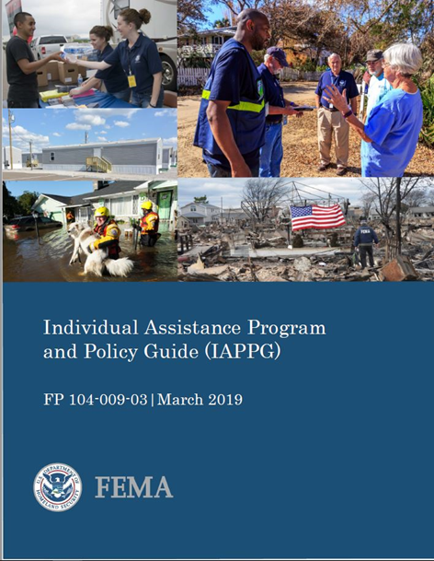
Individual Assistance Program and Policy Guide (IAPPG)
Comprehensive policy resource effective March 1, 2019 (update planned for release in March 2020)
For all stakeholders who assist survivors with post-disaster recovery
Succeeds Individuals and Households Program Unified Guidance published September 30, 2016
Supersedes individual program guidance for Individual Assistance (IA) programs
Consolidates policy statements for all IA programs
Chapter 1: Introduction
Chapter 2:
Mass Care
Chapter 3: Individuals and Households Program
Chapter 4: Disaster Case Management
Chapter 5: Crisis Counseling Program
Chapter 6: Disaster Legal Services
Chapter 7: Disaster Unemployment Assistance
Chapter 8: Voluntary Agency Coordination
Notes:
Since 2016, the Individual Assistance Division (IA) has built on the information in the original IHPUG as well as other program’s individual guidance to develop a single policy resource for all IA programs: the IAPPG.
The IAPPG:
Is a comprehensive policy resource for State, Territorial, Tribal and local governments; non-governmental partners; and other entities who assist disaster survivors with post-disaster recovery
Succeeds the Individuals and Households Program Unified Guidance published September 30, 2016
Supersedes individual program guidance for Individual Assistance (IA) programs
Consolidates policy statements for all IA programs, including the Individuals and Households Program, Disaster Case Management, Crisis Counseling Program, Disaster Unemployment Assistance, Disaster Legal Services, and programs and activities under the Mass Care and Voluntary Agency Coordination sections

Slide 4
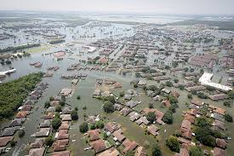
IHP Housing Assistance
Temporary Housing
Home Repairs
Home Replacement
Permanent Housing Construction

Slide 5
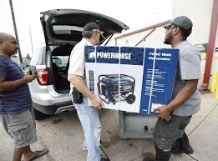
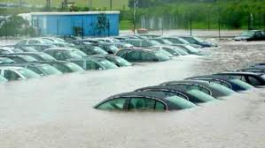
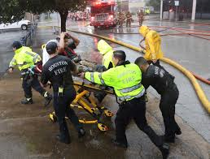
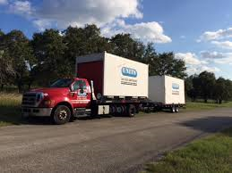
IHP Other Needs Assistance (ONA)
SBA/income dependent categories
Personal Property
Transportation – repair and replacement amounts set by State
Moving and Storage Expenses
Group Flood Insurance Policy
Notes:
Other Needs Assistance (ONA)
Assistance from ONA is cost-shared between FEMA (75%) and the State (25%). Applicants may receive financial assistance for other disaster-caused expenses and serious needs. The types of ONA are divided into two categories that are either dependent or non-dependent on the applicant’s ability to secure a U.S. Small Business Administration (SBA) disaster loan. The SBA may provide low-interest, long-term loans to help applicants with transportation losses, moving and storage expenses, as well as repair/replacement funds for real and personal property damage caused by the disaster. Only applicants who do not qualify for a loan from the SBA may be eligible for assistance for an SBA-dependent category. SBA-dependent ONA includes Personal Property, Moving and Storage, and Transportation Assistance.
State Administration of Other Needs Assistance
The State may request a grant from FEMA for State administration of ONA. You should consult with FEMA Regional staff to learn more about options for administering ONA. As stated above, the cost share for ONA is Federal (75%) and State (25%).
The state, territorial, or tribal government also uses the ONA Administrative Option Selection form to identify limits for specific ONA items and establish maximum award amounts for Transportation Assistance, Funeral Assistance, and Child Care Assistance. Additional line items, other than those on FEMA’s Standard Personal Property Line Items list, may be requested when submitting or updating the ONA Administrative Option Selection form.
The Standard Personal Property Line Items list identifies all ONA-eligible personal property and miscellaneous items, as well as the maximum number of items each individual or household may receive. The state, territorial, or tribal government submits the applicable forms to the RA, who reviews and approves the documentation. FEMA Headquarters also reviews the documentation to ensure consistency across disasters and for implementation.
State, territorial, or tribal governments, which select the Joint or the State, Territorial, or Tribal Government Option, must also submit a State Administrative Plan (SAP) every three years. The SAP describes the procedures the state, territorial, or tribal government will use to administer ONA.128 The RA must review and approve the SAP prior to submitting the documentation to FEMA Headquarters for coordination of implementation.
The ONA Administrative Option Selection form and the SAP may be changed during any non-disaster time period or within three days of a major disaster declaration. However, in order for a state, territorial, or tribal government to change to the Joint Option or State, Territorial, or Tribal Government Option, they must submit a SAP.
ONA Categories
An applicant does not apply for ONA, but is referred for assistance based on his or her ability to secure a loan from the U.S. Small Business Administration. If the SBA determines that an applicant cannot afford a loan, SBA will automatically refer that applicant back to ONA for additional help.
ONA can be provided for disaster-related serious needs in four categories:
Personal Property: Financial assistance may be available to repair or replace items that were damaged or destroyed as a result of the disaster and that are not covered by insurance. FEMA will not pay for all damaged or destroyed personal property. A flood insurance purchase and maintenance requirement may be placed on the personal property if the property is in a Special Flood Hazard Area. Repair and replacement may include:
o Clothing
o Household items (room furnishings, appliances)
o Specialized tools or job-related protective clothing and equipment
o Necessary educational materials (such as school books)
o Clean-up items (such as wet/dry vacuum, air purifier, dehumidifier)
Transportation: Financial assistance is available to address the cost of repairing and/or replacing an individual’s primary vehicle that is no longer usable because of disaster-related damage.
Moving and Storage expenses: FEMA may provide financial assistance under the ONA provision of the IHP to individuals and households to avoid additional disaster damage. Generally this includes storage of personal property while repairs are being made to the primary residence and returning the property to the applicant’s primary residence. FEMA may provide assistance with eligible moving and storage expenses through the period of assistance or up to the IHP financial assistance maximum award, whichever comes first.
Group Flood Insurance Policy: $600 flat fee paid directly to National Flood Insurance Program for 3 years of coverage beginning 30 days after declaration; all GFIP policies expire 37 months from declaration regardless of individual start date

Slide 6
IHP Other Needs Assistance (ONA)
Non-SBA/income dependent categories
Funeral Expenses – category max set by State
Medical and Dental Expenses
Child Care Expenses
*Clean and Removal Assistance
*Critical Needs Assistance
Miscellaneous Expenses
*Disaster-specific implementation
Notes:
Non-SBA Dependent Categories
The following types of assistance are non-SBA-dependent, and FEMA does not require the applicant to apply for an SBA loan before being considered for these types of ONA. FEMA may award applicants Funeral Assistance and Child Care Assistance up to the limits established by the state, territorial, or tribal government in the ONA Administrative Option Selection Form, rather than paying fixed amounts based on FEMA inspection verification.
Funeral and Burial Costs: FEMA provides financial assistance under the ONA provision of the IHP to individuals and households with disaster-caused funeral expenses. Unlike most other forms of IHP Assistance, an applicant seeking Funeral Assistance does not need to live in the Presidentially-declared disaster area to be considered for the assistance. An individual who incurs or will incur expenses related to a death or disinterment attributed directly or indirectly to a declared emergency or major disaster may apply for and, if eligible, receive Funeral Assistance. Multiple registrations for the same deceased are not allowed. The affected state, territorial, or tribal government establishes the maximum amount of Funeral Assistance that may be awarded per death or per household as part of the ONA Administrative Option Selection form.
Medical and Dental Expenses: FEMA provides financial assistance under the ONA provision of the IHP to individuals and households with medical or dental expenses caused by a disaster. Unlike most other forms of IHP Assistance, an applicant seeking Medical or Dental Assistance does not need to live in the Presidentially-declared disaster area to be considered for the assistance. Any person who incurs disaster-caused medical or dental expenses may apply for and, if eligible, receive Medical or Dental Assistance.
Childcare Expenses: FEMA provides financial assistance under the ONA provision of the IHP to eligible individuals and households who have a disaster-caused increased financial burden for child care. FEMA will award a one-time payment for Child Care Assistance for the household’s increased financial burden for up to eight cumulative weeks of child care, plus any eligible expenses, or the maximum amount of assistance for Child Care Assistance identified by the state, territorial, or tribal government, whichever is less. FEMA may provide financial assistance to address increased disaster-caused child care expenses for eligible households with:
Children aged 13 and under; and/or
Children with a disability, as defined by Federal law, up to age 21, who need assistance with activities of daily living.
The respective state, territorial, or tribal government must establish the maximum amount of Child Care Assistance on a per-child or per-household basis as part of the annual ONA Administrative Option Selection process.
Clean and Removal Assistance: FEMA may provide a limited amount of financial assistance to individuals and households with disaster-caused real property damage who do not qualify for Home Repair Assistance because the damage did not render the home uninhabitable. Clean and Removal Assistance (CRA) is intended to ensure contamination from floodwaters is addressed in a timely manner to prevent additional losses and potential health and safety concerns. Individual property owners will be responsible for performing or contracting for services to remove contaminants and disinfect surface areas of their homes that have been affected by floodwater. An affected state, territorial, or tribal government must submit a written request to FEMA to implement CRA. The GAR must submit a written request for CRA to the FCO. CRA may only be requested in disasters where “flood” is listed as an incident type. CRA must be approved by the RA prior to implementation. The eligibility period for CRA will correspond to the standard FEMA registration period of 60 days, but will not include extension periods unless specifically authorized by the RA.
Critical Needs Assistance: FEMA may provide financial assistance under the ONA provision of the IHP to applicants who have immediate or critical needs because they are displaced from their primary dwelling. Immediate or critical needs are life-saving and life-sustaining items including, but not limited to: water, food, first aid, prescriptions, infant formula, diapers, consumable medical supplies, DME, personal hygiene items, and fuel for transportation. An affected state, territorial, or tribal government must submit a written request to FEMA to implement CNA. FEMA’s IA Division Director may authorize assistance when the majority of applicants from the declared area are or will be displaced from their primary residence for an extended period of time, generally 7 days or more. The affected state, territorial, or tribal government will have 14 days from the date of the declaration to submit the request for CNA. CNA will be approved for the initial 14-day period from the date of the Presidential declaration. When necessary based on applicant need, this period of assistance may be extended by the IA Division Director if requested by the affected state, territorial, or tribal government.
Other Miscellaneous Items/Expenses: FEMA provides financial assistance under the ONA provision of the IHP to individuals and households with certain disaster-caused miscellaneous expenses. Eligible items must be purchased or rented after the incident to assist with the applicant’s disaster recovery, such as gaining access to the property or assisting with cleaning efforts. Items damaged by the disaster that were owned prior to the disaster will be considered under Personal Property Assistance. State, territorial, and tribal governments, in consultation with FEMA, have identified standard miscellaneous line items. However, the state, territorial, or tribal government may elect not to include all of these items as eligible for reimbursement:
Carbon Monoxide Detector
Chainsaw
Dehumidifier
Generator
Humidifier
Smoke Detector
Weather Radio
State, territorial, and tribal governments may request additional miscellaneous line items on the ONA Administrative Option Selection form, during any non-disaster time period or within 72 hours of a major disaster declaration.
Disability Support may also be provided in the form of equipment required to accommodate disabilities and access/functional needs.
Remind participants that benefits cannot be duplicated. If applicants have a current insurance policy that covers expenses, then those benefits cannot be duplicated by FEMA benefits.

Slide 7
IHP General Eligibility Criteria
County, incident date, and cause of damage designated in declaration
U.S. citizen, non-citizen national, or qualified alien
Verifiable identity
Uninsured or underinsured losses
Necessary experiences and serious needs
IHP is not a substitute for insurance and cannot compensate for all losses caused by a disaster; it is intended to meet survivors’ basic needs and supplement disaster recovery efforts.

Slide 8
What IHP decisions can be appealed?
Initial eligibility determinations for Housing Assistance and Other Needs Assistance (ONA), including:
Amount or type of Housing Assistance and/or ONA an applicant received;
Decision to withdraw application for FEMA disaster assistance;
Recovery of funds improperly awarded; or
Denial of a late application request for assistance
Denial for Continued Rental Assistance
Notes:
Housing Assistance: If FEMA determines the residence was not destroyed by the disaster, the applicant may appeal by submitting supporting documentation from governing authorities giving notice of condemnation, substantial damage, or demolition.
FEMA will not automatically determine an applicant eligible for Replacement Assistance based on submitted documentation, because local authority determinations could be based on non-disaster-caused circumstances.
After receiving appeal documentation from the applicant, FEMA will review the request to determine if another inspection is necessary in order to verify if the residence was destroyed due to disaster-caused damage.
SBA-dependent assistance incudes Personal Property assistance, Transportation assistance, Moving and Storage assistance, and a Group Flood Insurance Policy certificate. Applicants, who were originally referred to the SBA and either did not qualify for a SBA loan or who were approved for a partial loan that was insufficient to meet their disaster expenses or serious needs, may be referred back to FEMA to determine if they are eligible for these types of ONA.
Personal Property: Personal property is divided into four categories: Appliances, Clothing, Room, and Essential tools. Eligibility for these items is typically determined during inspection. To be eligible for Personal Property assistance applicants must have the failed income test, been denied an SBA loan, or received a limited SBA loan that is insufficient to cover their essential personal property needs.
Clothing: FEMA identifies an essential need for clothing when the existing clothing has been destroyed, is physically gone (e.g., blown away), or is contaminated by chemicals or sewer backup as a result of a disaster. Clothing that is saturated by wind-driven rain, seepage, or flood waters is expected to be cleaned. This assistance is based on the number of household members who require clothing as recorded at the time of the FEMA inspection. It is awarded as a lump sum with a quantity limit of one per each household member recorded. Stored clothing is generally not eligible for assistance.
Appliances: ONA Personal Property Assistance for appliances is intended to cover common appliances that applicants need to for their home to function normally. Applicants may receive assistance for two appliances that serve a similar purpose or function (e.g., a range and a microwave). In addition, several line items included in the Appliance listings are not typically considered appliances. Specific furniture items are listed as appliances in order to record these items separately from room furnishings or add items that are not included in any room awards.
Room Furnishings: This assistance is based on the level of damage to furnishings within specific rooms of the residence as recorded during the FEMA inspection. The 4 types of eligible rooms under ONA are kitchen, living room, bathroom, and bedrooms. Rooms include standard household items and furnishings in each room such as beds, towels, sheets, kitchen items, etc. There is a limit of one (1) each for the kitchen, living room and bathroom. The bedroom limit is based on the number of occupied bedrooms identified in the inspection report.
Essential Tools: Essential Tools consist of tools and equipment required by an employer as a condition of employment or items required as a condition of an applicant’s or dependent household member’s education. This includes tools and equipment required for a specific trade or profession. The inspector will not record damage to essential tools required for self-employment.
Moving and Storage Expenses: Moving and Storage assistance is to help owners and renters with expenses to move and store essential personal property, to prevent further disaster-caused damage, and return or move the property to their primary residence.
Transportation: Transportation expenses are identified by an on-site inspection or through a mechanic’s statement. Transportation awards may not exceed the amount set by the state. In the disaster set-up process for vehicles listed as “Repairable”, if the repair limit is set at a dollar amount “up to” the replacement amount, then assistance over the repair limit is possible if all other verifications are met. However, no assistance is should be awarded over the replacement limit. If the repair limit does not state “up to” the replacement limit, then assistance should not be provided over the given repair limit. Eligible vehicles include but may not be limited to vans, trucks, Sport Utility Vehicles (SUVs), and cars. Disaster specific circumstances may require the addition of other modes of transportation. Examples of other modes of transportation include boats, motorcycles, golf carts, or other non-standard modes of primary transportation. The cost of obtaining a repair estimate is also an eligible expense.
Non-SBA-dependent assistance includes Medical, Dental, Funeral, Child Care, and Miscellaneous/Other Expenses. FEMA does not require applicants to apply for a SBA loan, no matter their income, before being considered for these types of ONA.
Medical and Dental: Uninsured Medical and Dental expenses that are disaster-caused may be eligible for assistance. Eligible expenses include but may not be limited to the treatment of an injury or illness, hospitalization, ambulance services, replacement or purchase of prescribed medication, and the replacement, repair or purchase of new medical or dental equipment. Assistance for these categories is addressed only through submitted documentation.
Other Miscellaneous Items: Miscellaneous/Other items that are needed as a result of the disaster to assist with the applicant’s recovery may be eligible for reimbursement if they are purchased, rented or leased. Assistance will be awarded based upon either an on-site inspection verification or submitted documentation. Inspections are not a requirement.
Recovery of Program Funds (recoupment): Federal agencies are required to take action to identify and recover improper payments, whether made in error or obtained by fraud, per the following Federal laws: Debt Collection Improvement Act of 1996 (DCIA); Improper Payments and Information Act of 2002 (IPIA); Improper Payments Elimination and Recovery Act of 2010 (IPERA); and Improper Payments Elimination and Recovery Improvement Act of 2012 (IPERIA). In addition, the applicant must agree to return funds to FEMA when the assistance provided by FEMA duplicates assistance from another source, was provided in error, was spent on expenses inappropriately, or was obtained through fraudulent means. After every disaster, FEMA is required to review disaster assistance payments to ensure taxpayer dollars were properly spent. Those reviews often show a small percentage of specific cases where disaster assistance was given to applicants who were not eligible for some or all of the money they received. FEMA collects these overpayments through a process called “recoupment.” FEMA employs a deliberative process to identify and verify payments that must be recouped and established as debts. This process involves multiple levels of FEMA staff and management review and validation before a debt is established. When FEMA determines assistance was given to applicants who were not eligible for some or all of the money received, FEMA IA program staff notifies the applicant in writing of their potential debt and their right to appeal the decision. After the applicant exhausts their appeal rights or the period to appeal the debt expires, a debt is officially established. The FEMA Finance Center (FFC) will send a letter to the applicant to provide information on repayment options. FEMA considers expenses associated with the time and resources required to prepare and follow up on a potential debt to determine if the costs of recovering the potential debt will exceed the amount owed. FEMA will not initiate recoupment activity for any potential debt valued less than $250.00 unless a significant enforcement principle is at stake.
Multiple FEMA managers are required to review each case and concur on the type and amount of assistance that must be returned. FEMA managers also review the case to ensure all appropriate steps to resolve the issue were taken. When FEMA managers determine the assistance must be returned, a written notice is sent to the applicant notifying them of their potential debt, the reason the applicant is not eligible for the assistance provided, and information regarding how they may appeal and/or request an oral hearing.
Applicants may request an oral hearing as part of their written appeal. FEMA will only grant oral hearings in limited cases, when there is an issue of identity theft, credibility, or truthfulness, and the case cannot be decided solely on the review of documents. The Alternate Dispute Resolution Division within FEMA’s Office of Chief Counsel conducts the hearing. If the Oral Hearing Officer decides not to grant an oral hearing, that decision is final and cannot be appealed. The Oral Hearing Officer reviews all of the information regarding the case before the hearing. If the case was previously investigated for potential fraud, the Oral Hearing Officer’s review will include reports and information gathered during the investigation. During oral hearings, applicants are permitted to present information and witness statements to support their claim(s), and FEMA staff represent the Agency’s position. If a potential fraud investigation is conducted, a representative from the Fraud Investigation and Prevention Branch will present information about the investigation and report during the oral hearing. Oral hearing decisions are considered final agency determinations that cannot be appealed, and a decision letter drafted by the Oral Hearing Officer is mailed to the applicant.
If an applicant does not appeal the decision or their appeal is not granted, the debt becomes final and is forwarded to the FFC to continue debt collection activities.
Once a debt has been established, applicants may work with the FFC to make payment arrangements. In limited circumstances, the FFC may suspend or terminate debt collection.
If the applicant has not repaid the debt or has entered into a repayment plan within 120 days of FFC's letter, FEMA refers the debt to Treasury for collection. Significant additional costs will be incurred as a result of referral to Treasury.

Slide 9
What decisions can be appealed? (cont.)
Direct Housing Assistance determinations, including:
Termination of eligibility to remain in a temporary housing unit;
FEMA’s intent to collect rent or the amount of rent collected from occupants of a FEMA-provided temporary housing unit;
Denial of a request to purchase a FEMA-provided MHU;
Sales price of a FEMA-provided MHU the applicant may want to purchase;
Any Individual Assistance eligibility or participation-related determination, action or inaction
Notes:
Appeal of Direct Housing Unit Rent: If the primary occupant is unable to pay the amount of rent established by FEMA, they may appeal FEMA’s rent determination within 60 days of receiving FEMA’s notice of the requirement to pay monthly rent. Appeals must include documentation demonstrating the applicant does not have the financial ability to pay the established rent. Specifically, FEMA requires both of the following information:
Pre-disaster versus post-disaster monthly gross income of all household occupants age 18 or older; and
Pre-disaster versus post-disaster monthly housing costs, such as mortgage payments on the pre-disaster residence while it is being repaired.
FEMA may adjust the amount of rent using the following criteria:
If the total monthly adjusted gross income amount of all occupants 18 years of age and older remained the same subsequent to the disaster, FEMA will consider the primary occupant capable of paying the same monthly amount for housing costs paid before the disaster or 30% of their household income, whichever is greater, but not to exceed the FMR.
If the total monthly gross adjusted income amount of all occupants 18 years of age and older increased or decreased as a result of the disaster, FEMA will consider the primary occupant capable of paying a monthly amount for housing costs equal to 30% of their household income or the FMR, whichever is greater, but not to exceed the FMR.
FEMA will subtract post-disaster monthly housing costs from the amount FEMA considers the primary occupant is capable of paying for housing costs to determine the FEMA adjusted rent amount to be charged, up to the applicable FMR. Housing costs may include rent and/or mortgage payments (including principal, interest, and real estate taxes) on the pre-disaster primary residence, real property insurance, and utility costs (not to include cable television, internet, and telephone service).
FEMA will not charge any primary occupant more than the FMR for monthly rent.
FEMA will not charge any primary occupant less than the FEMA minimum monthly rent amount of $50.
Rent for a THU will continue to accrue each month while FEMA is considering the appeal, which may take up to 90 days.
If the appeal is denied, the primary occupant must pay the originally established rent in total within 30 days of the date of the appeal decision, including any rent not paid while FEMA was considering the appeal; or
If the appeal is granted, the primary occupant must pay the adjusted rent in total within 30 days of the date of the appeal decision:
If the primary occupant paid the originally established rent amount while FEMA considered the appeal, FEMA will reimburse any overpayment based upon the amount of the adjusted rent.
DH Appeal Rights: If the occupant fails to remedy the violation as outlined in the 15-day notice or commits a Major Violation, FEMA will issue the primary occupant a Notice of Revocation (NOR) explaining the reason(s) for terminating Direct Temporary Housing Assistance, instructions for submitting an appeal, and that assistance is terminated as of the date of the letter. Occupants can appeal the termination decision within 60 days after receiving the NOR. However, filing an appeal does not relieve the occupant of the responsibility to vacate the THU by the deadline established in the NOR. Also, the occupant cannot appeal an NOR received due to the end of the period of assistance. Primary occupants may appeal FEMA’s decision to terminate assistance; however, the penalty fee may not be appealed. If FEMA accepts the appeal, overturns the termination, and reinstates Direct Temporary Housing Assistance, the occupant will not be required to pay a penalty fee. FEMA will refund the applicant any penalty fees the applicant paid during the appeal period.
Determining the Price of the Unit: MHU: FEMA will offer to sell the MHU to the primary occupant at the Adjusted Fair Market Value (AFMV), which is the fair market value minus a standard deduction of FEMA’s average deactivation cost.
RV: FEMA will determine the Fair Market Value (FMV) of the RV using the National Automobile Dealers Association (NADA) pricing guide and subtract FEMA’s average deactivation cost to determine the AFMV. FEMA may lower the sales price based upon the occupant’s financial ability but will not reduce the sales price to less than 25% of the AFMV.107 If the occupant feels they cannot afford to purchase the unit at the AFMV, the occupant may appeal FEMA’s determination and petition for a reduced sales price.

Slide 10
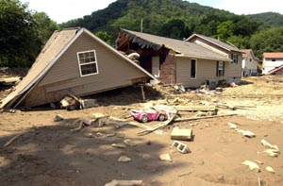
IHP Appeal Submissions
IHP Appeal letters must:
Be submitted in writing within 60 calendar days of IHP decision letter
Late submissions require a reason for missed deadline
Explain reason(s) for appeal
Be signed by applicant, co-applicant, or person authorized by applicant to act on his/her behalf
If someone other than applicant or co-applicant signs, a written consent from the applicant is required
Notes:
All appeal requests must be in writing, either typed or hand written. Signed estimates, bills, receipts, ledgers, contracts, etc. are not acceptable in lieu of an appeal letter. Verbal appeal requests are not acceptable.
An applicant may appeal within sixty (60) days of date on his or her FEMA decision letter. This deadline applies for both eligible and ineligible decisions.
Applicants with insurance have twelve (12) months from the registration date to provide an insurance settlement or denial if their status is INS or INSFI. Upon receipt of the insurance documentation, the assistance will be processed in the FEMA Manual Determination queue as a second initial decision. The applicant will then have 60 days from this second insurance eligibility determination to submit an appeal.
If an appeal request is submitted after the 60 day appeal period, the applicant will be asked to provide a verbal or written statement explaining the reason for the late appeal submission.
The appeal letter should explain the reason(s) for the appeal. The reasons could include, for example, additional home repair assistance, additional assistance with personal property items, etc. The appeal letter should be accompanied by documentation to support the appeal reason, such as repair estimates, contractor estimates, or other supporting documentation.
The applicant or person acting on his/her behalf must sign the appeal letter. If the appeal is filed by a third party, the applicant or co-applicant must submit a signed statement authorizing the third party to appeal on their behalf, or have a valid Written Consent on file for the third party with authorization to appeal.

Slide 11
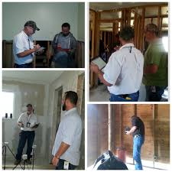
Appeal Submissions (cont.)
IHP Appeal letters must:
Include the following applicant information:
Full name
FEMA application and disaster numbers
Address of pre-disaster primary residence
Current phone number and mailing address
Include documentation to support appeal request, e.g., repair estimates, contractor estimates, or other supporting documentation
Notes:
If the appeal request is missing any of the requirements, an ADOC (appeal documentation request letter) will be mailed to the applicant or designated party requesting the missing information. One courtesy call to each number in the file will also be attempted to explain the needed documentation.
The goal for FEMA is to respond to an appeal as quickly as possible. Per the Stafford Act, FEMA is required to make a decision within 90 days of receiving the appeal.

Slide 12
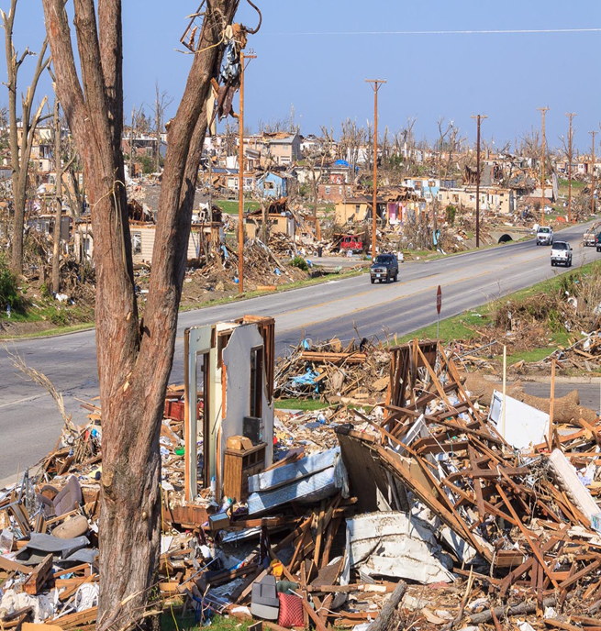
Requests for File Copy
Request must be in writing
Requested information must be specifically stated (e.g., entire file, all correspondence from FEMA, inspection report, etc.)
Designate who is to receive copy
If third party, full name and mailing address must be included

Slide 13
Requests for File Copy (cont.)
Include applicant identity verification information:
Full name
FEMA application and disaster numbers
Damaged property address or current mailing address
Date of birth
Signature with one of the following:
Notary stamp or seal; or
The statement, “I hereby declare under penalty of perjury that the foregoing is true and correct.”

